Slide 1
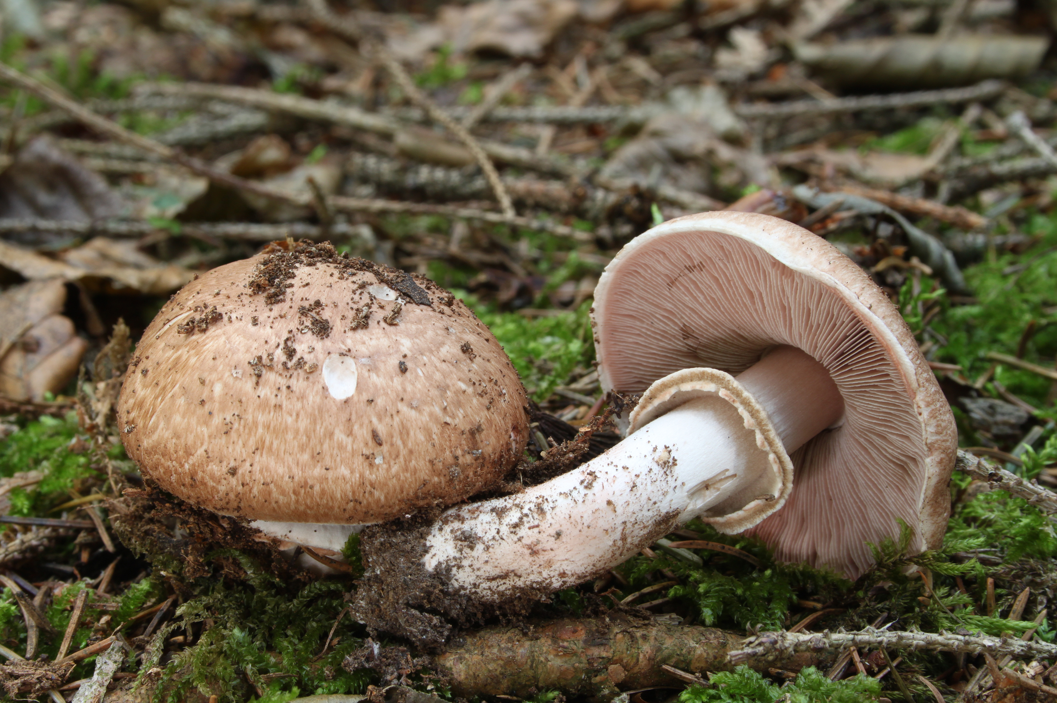
The Prediction of Mushroom Edibility Using Machine Learning
Benjamin W. Sturm
bwsturm@gmail.com
May 16, 2018

Slide 2

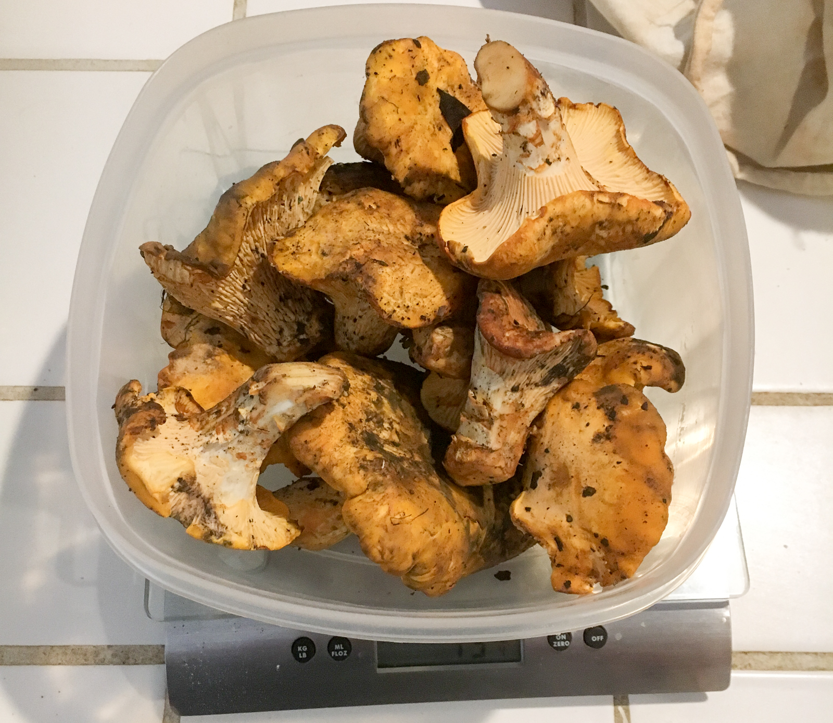
Hunting edible mushrooms in the wild can be an exciting and rewarding process
Hunter-Gatherers
The Trophy

Slide 3
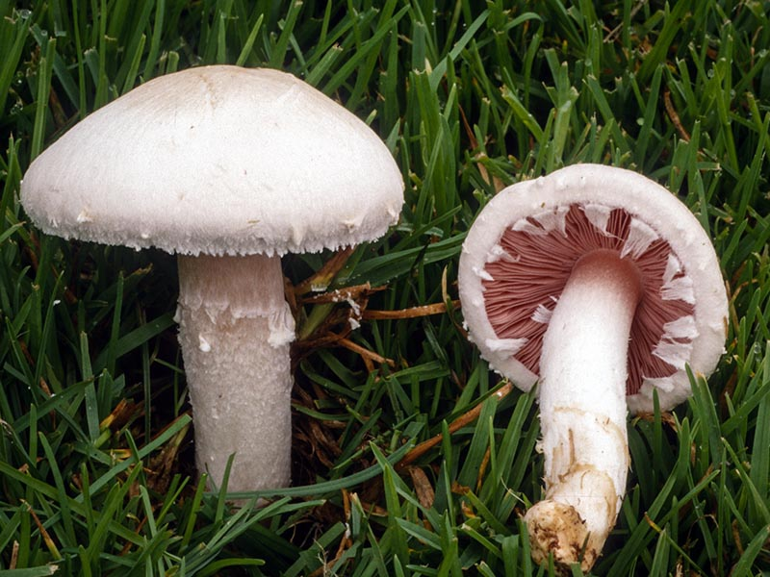
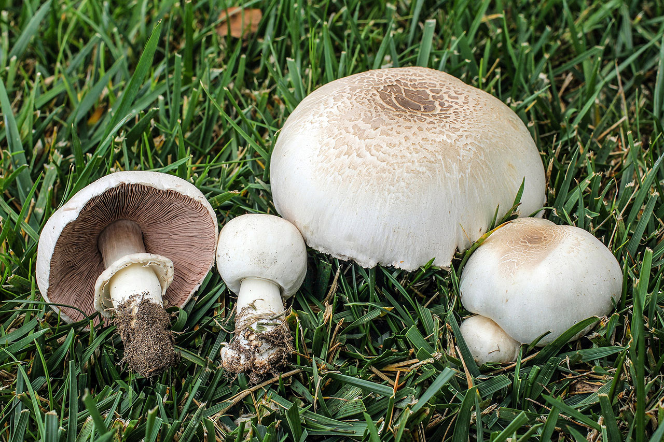
Wouldn’t it be great if you could determine whether a mushroom you encounter in nature is poisonous or not with machine learning?
Agaricus Campestris (Non-poisonous)
Agaricus Californicus (Poisonous)

Slide 4
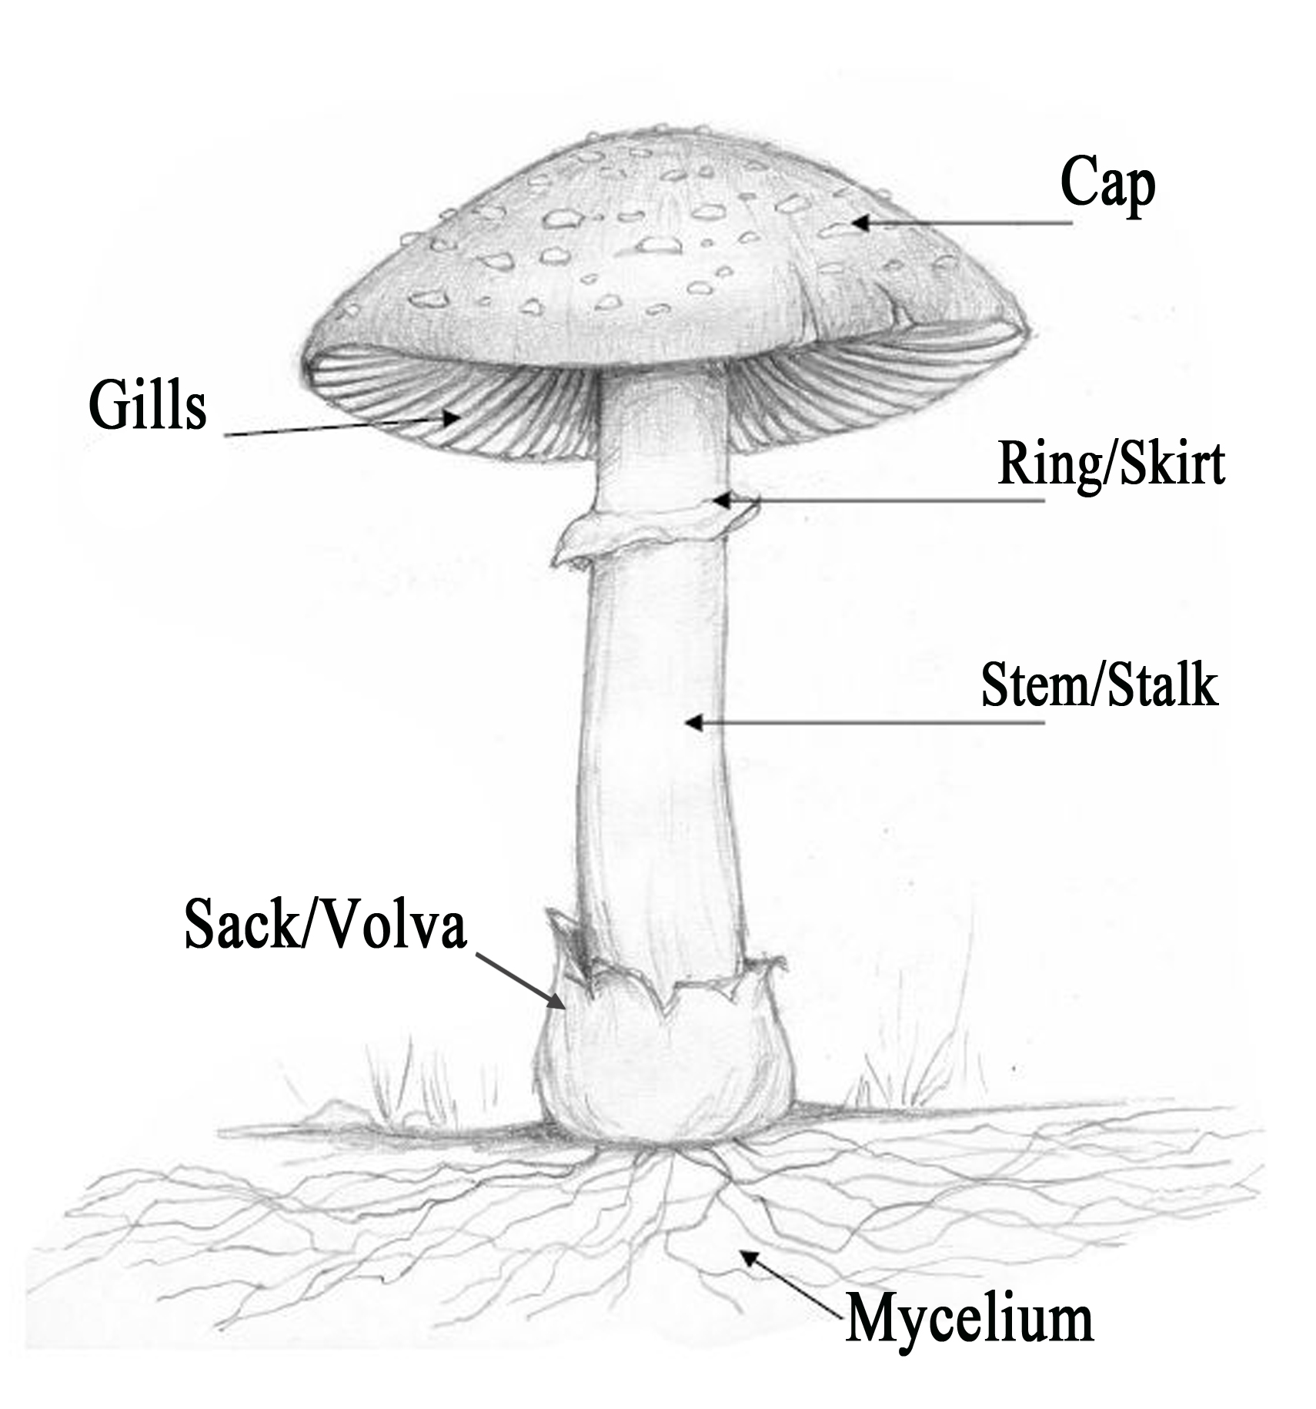
Wouldn’t it be great if you could determine whether a mushroom you encounter in nature is poisonous or not with machine learning?
 | Agaricus campestris (non-poisonous) | Agaricus californicus (poisonous)
cap color | white | whitish to brown
gill color | pink (young), chocolate brown (mature) | pink (young), chocolate brown (mature)
ring | no | yes
bruises? | no | yes
habitat | grass | forest and grass
odor | mild, mushroomy | antiseptic

Slide 5
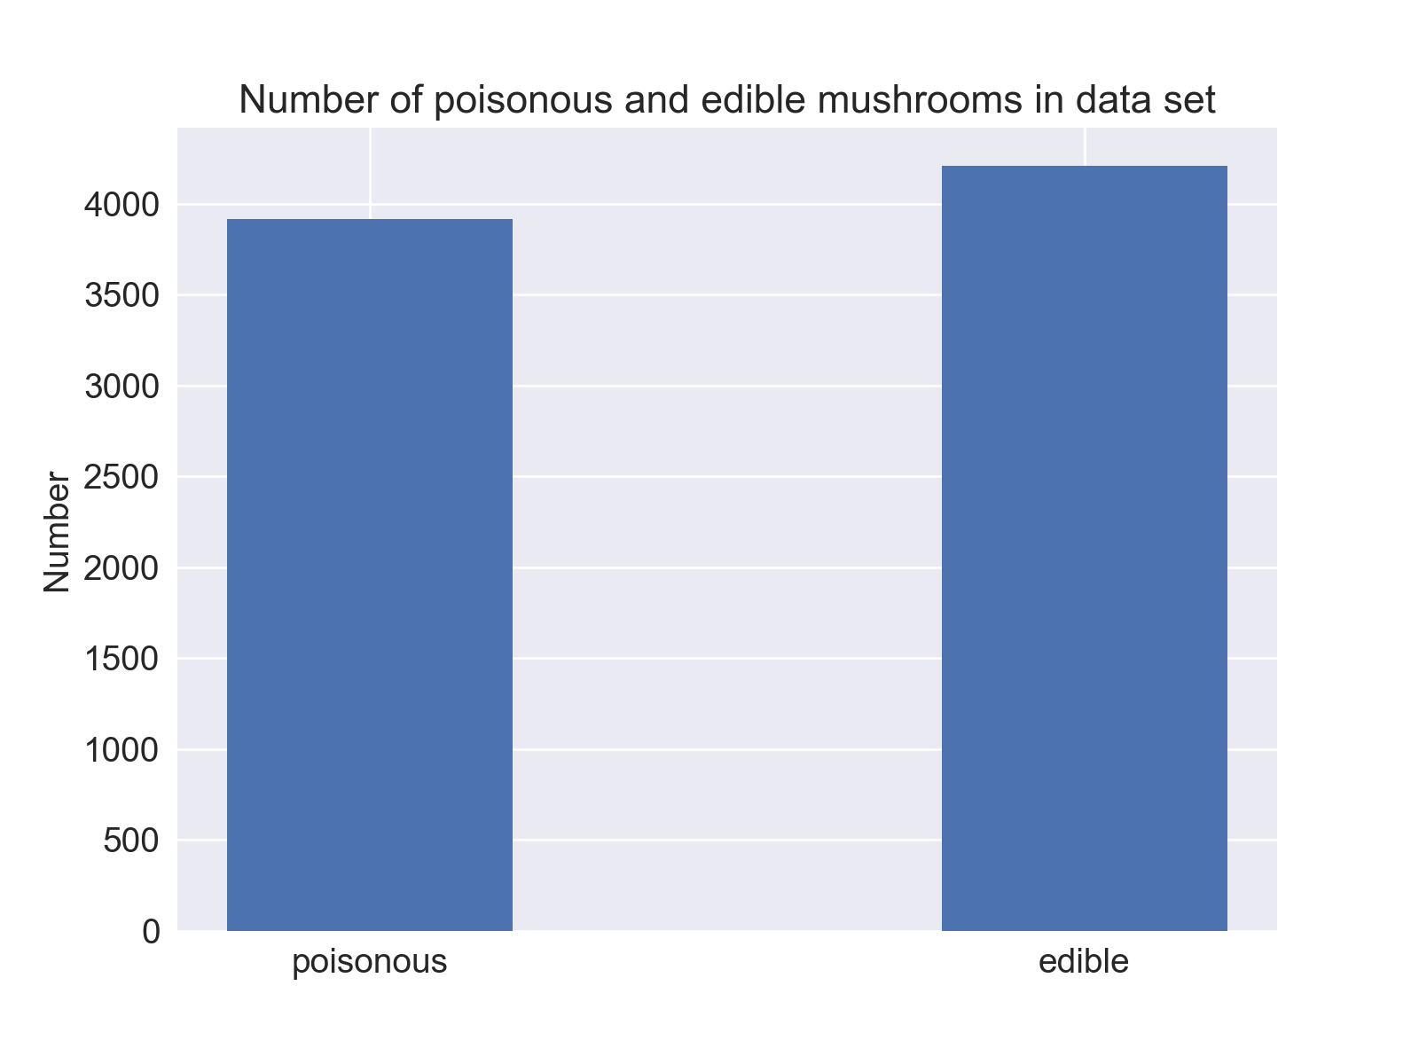
For this project, I used the UCI Mushroom Data Set to determine if machine learning could be used to classify the edibility of mushrooms
The data set consists of mushrooms from 2 different families only (Agaricus, Lepiota)
Number of instances = 8124
Number of features = 22
All features are categorical
Target variable is edibility
52% edible
48% non-edible

Slide 6
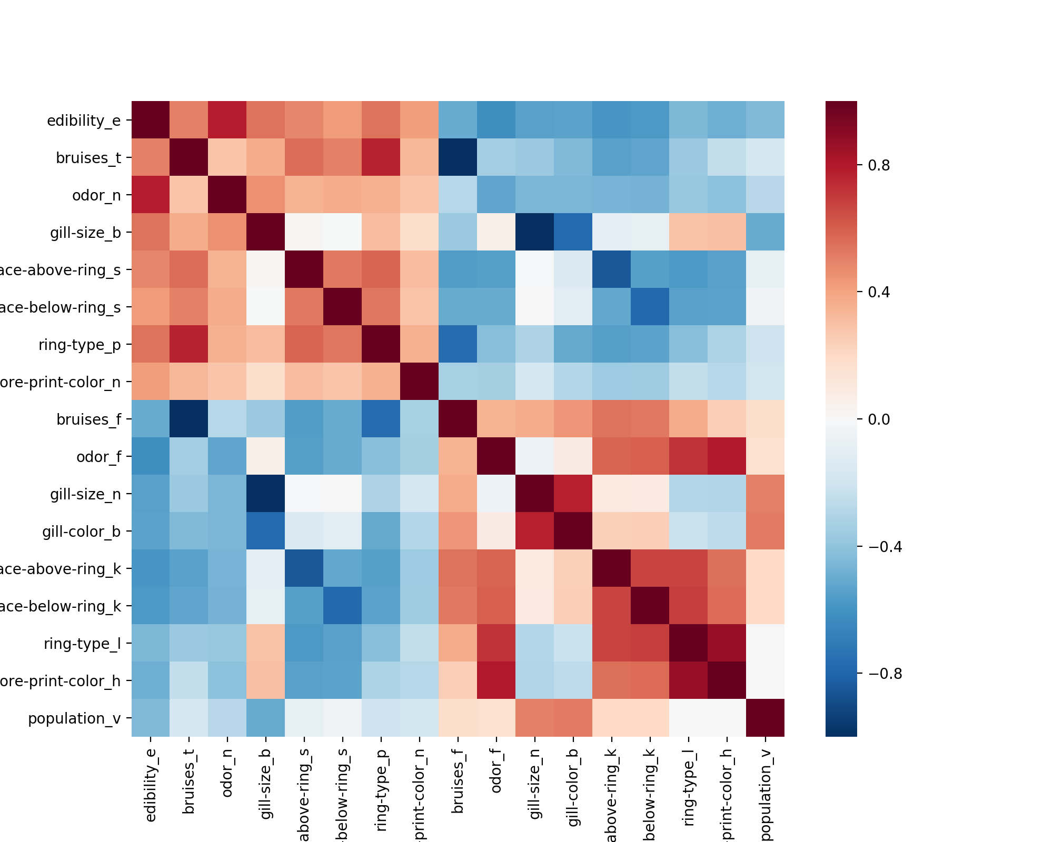
Certain features are strongly correlated with edibility
Corr = .786
Corr = -.624
Edibility
Odor - None
Odor - Foul

Slide 7
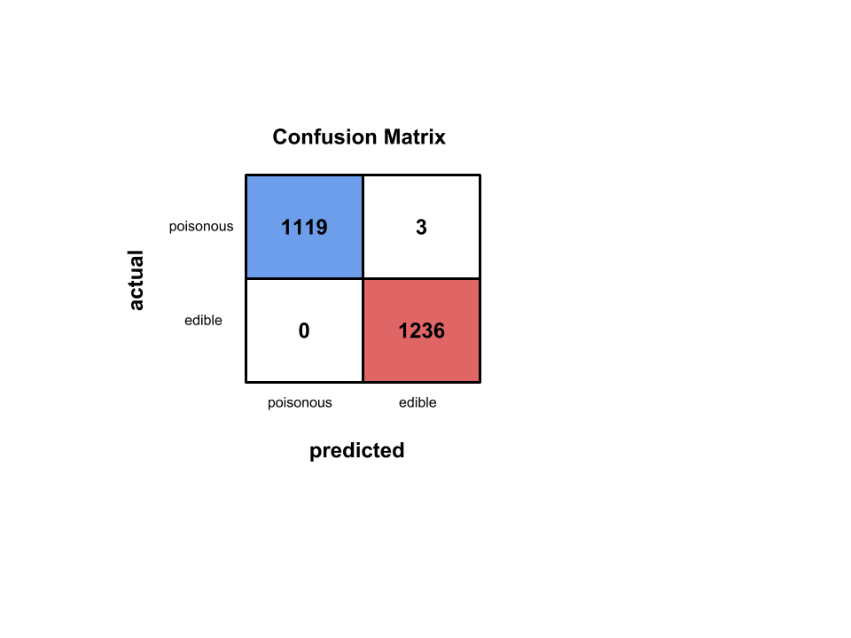
Baseline model using logistic regression has near perfect accuracy
Logistic Regression Results with default parameters
Model | Precision | Recall | Accuracy
Log. Reg. | 0.998 | 1.000 | 0.999

Slide 8
Which features are most important for predicting edibility?
Logistic regression important coefficients
For these 2 families of mushrooms, odor is one of the most important features
Edible odors
n = None, l = anise, a = almond
Poisonous odors
p = pungent, f = foul, c = creosote
Feature | Beta
odor_n | 4.064
odor_l | 2.656
odor_a | 2.647
gill-size_b | 1.959
gill-spacing_c | -1.522
stalk-surface-above-ring_k | -1.665
gill-color_b | -1.799
gill-size_n | -2.067
odor_p | -2.253
stalk-root_b | -2.287
odor_f | -2.608
odor_c | -2.638
spore-print-color_r | -3.331

Slide 9
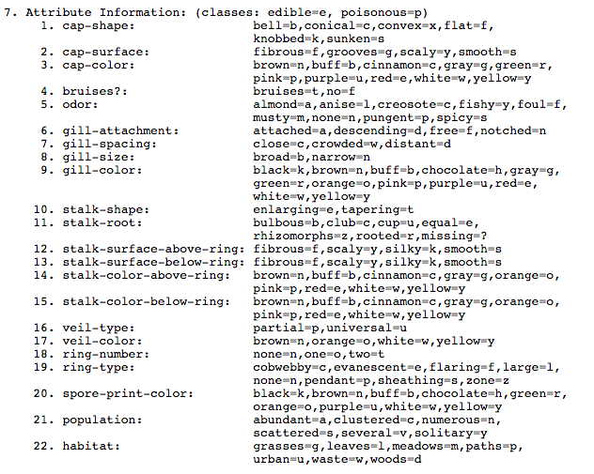
Appendix: Mushroom Attribute Information

